Slide 1

The Economics of Money, Banking, and Financial Markets
Twelfth Edition, Global Edition
Chapter 6
The Risk and Term Structure of Interest Rates
Copyright © 2019 Pearson Education, Ltd.
Notes:
If this PowerPoint presentation contains mathematical equations, you may need to check that your computer has the following installed:
1) MathType Plugin
2) Math Player (free versions available)
3) NVDA Reader (free versions available)

Slide 2
Preview
In this chapter, we examine the sources and causes of fluctuations in interest rates relative to one another and look at a number of theories that explain these fluctuations.

Slide 3
Learning Objectives
Identify and explain three factors explaining the risk structure of interest rates.
List and explain the three theories of why interest rates vary across maturities.

Slide 4
Bonds with the same maturity

Slide 5
Risk Structure of Interest Rates (1 of 3)
Bonds with the same maturity have different interest rates due to:
Default risk
Liquidity
Tax considerations

Slide 6
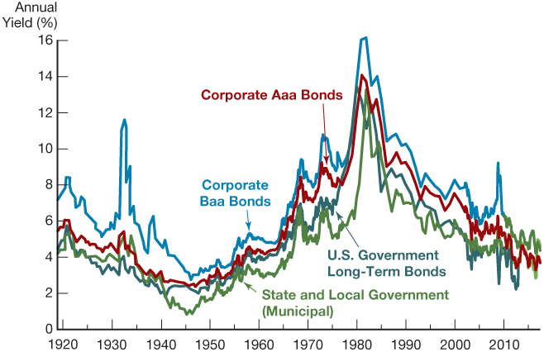
Long-Term Bond Yields, 1919–2017
Sources: Board of Governors of the Federal Reserve System, Banking and Monetary Statistics, 1941–1970; Federal Reserve Bank of St. Louis FRED database: http://research.stlouisfed.org/fred2

Slide 7
Risk Structure of Interest Rates (2 of 3)
Default risk: probability that the issuer of the bond is unable or unwilling to make interest payments or pay off the face value
U.S. Treasury bonds are considered default free (government can raise taxes).
Risk premium: the spread between the interest rates on bonds with default risk and the interest rates on (same maturity) Treasury bonds

Slide 8
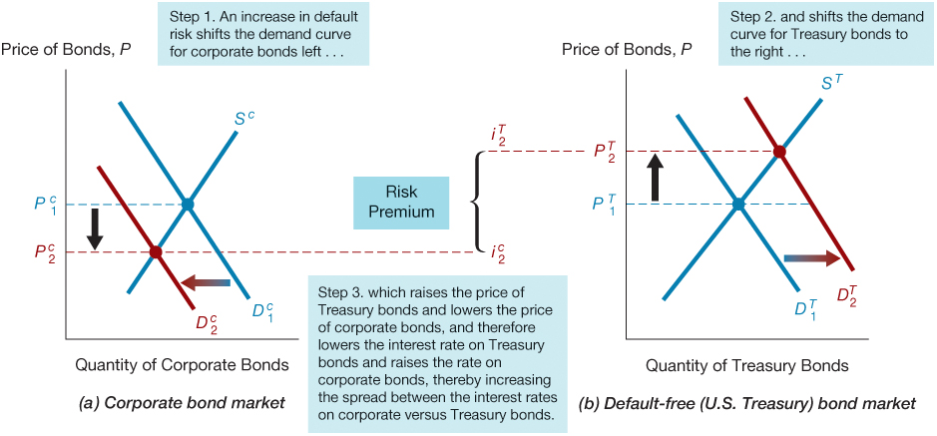
Response to an Increase in Default Risk on Corporate Bonds

Slide 9
Bond Ratings by Moody’s, Standard and Poor’s, and Fitch (1 of 2)
Moody’s | Rating Agency S&P | Fitch | Definitions
Aaa | AAA | AAA | Prime Maximum Safety
Aa1 | AA+ | AA+ | High Grade High Quality
Aa2 | AA | AA | Blank
Aa3 | AA– | AA– | Blank
A1 | A+ | A+ | Upper Medium Grade
A2 | A | A | Blank
A3 | A– | A– | Blank
Baa1 | BBB+ | BBB+ | Lower Medium Grade
Baa2 | BBB | BBB | Blank
Baa3 | BBB– | BBB– | Blank
Ba1 | BB+ | BB+ | Noninvestment Grade

Slide 10
Bond Ratings by Moody’s, Standard and Poor’s, and Fitch (2 of 2)
Moody’s | Rating Agency S&P | Fitch | Definitions
Ba2 | BB | BB | Speculative
Ba3 | BB– | BB– | Blank
B1 | B+ | B+ | Highly Speculative
B2 | B | B | Blank
B3 | B– | B– | Blank
Caa1 | CCC+ | CCC | Substantial Risk
Caa2 | CCC | — | In Poor Standing
Caa3 | CCC– | — | Blank
Ca | — | — | Extremely Speculative
C | — | — | May Be in Default
— | — | D | Default

Slide 11
Risk Structure of Interest Rates (3 of 3)
Liquidity: the relative ease with which an asset can be converted into cash
Cost of selling a bond
Number of buyers/sellers in a bond market
Income tax considerations
Interest payments on municipal bonds are exempt from federal income taxes.

Slide 12
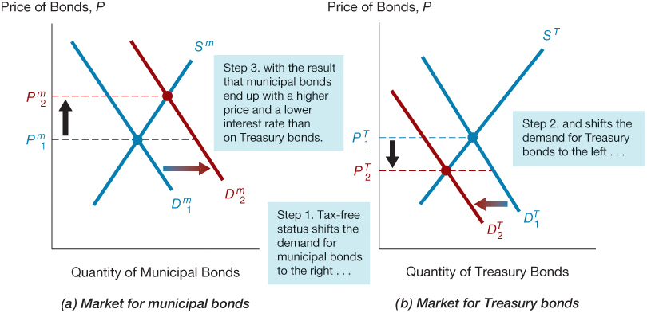
Interest Rates on Municipal and Treasury Bonds

Slide 13
Effects of the Obama Tax Increase on Bond Interest Rates
In 2013, Congress approved legislation favored by the Obama administration to increase the income tax rate on high-income taxpayers from 35% to 39%.
Consistent with supply and demand analysis, the increase in income tax rates for wealthy people helped to lower the interest rates on municipal bonds relative to the interest rate on Treasury bonds.

Slide 14
Bonds with identical risk

Slide 15
Term Structure of Interest Rates (1 of 4)
Bonds with identical risk, liquidity, and tax characteristics may have different interest rates because the time remaining to maturity is different.

Slide 16
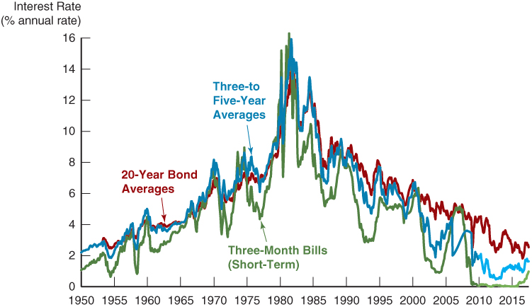
Movements over Time of Interest Rates on U.S. Government Bonds with Different Maturities
Sources: Federal Reserve Bank of St. Louis FRED database: http://research.stlouisfed.org/fred2/

Slide 17
Term Structure of Interest Rates (2 of 4)
Yield curve: a plot of the yield on bonds with differing terms to maturity but the same risk, liquidity, and tax considerations
Upward-sloping: long-term rates are above short-term rates
Flat: short- and long-term rates are the same
Inverted: long-term rates are below short-term rates

Slide 18
Term Structure of Interest Rates (3 of 4)
The theory of the term structure of interest rates must explain the following facts:
Interest rates on bonds of different maturities move together over time.
When short-term interest rates are low, yield curves are more likely to have an upward slope;
when short-term rates are high, yield curves are more likely to slope downward and be inverted.
Yield curves almost always slope upward.

Slide 19
Term Structure of Interest Rates (4 of 4)
Three theories to explain the three facts:
Expectations theory explains the first two facts but not the third.
Segmented markets theory explains the third fact but not the first two.
Liquidity premium theory combines the two theories to explain all three facts.

Slide 20
Expectations Theory (1 of 7)
The interest rate on a long-term bond will equal an average of the short-term interest rates that people expect to occur over the life of the long-term bond.
Buyers of bonds do not prefer bonds of one maturity over another; they will not hold any quantity of a bond if its expected return is less than that of another bond with a different maturity.
Bond holders consider bonds with different maturities to be perfect substitutes.

Slide 21
Expectations Theory (2 of 7)
An example:
Let the current rate on one-year bond be 6%.
You expect the interest rate on a one-year bond to be 8% next year.
Then the expected return for buying two one-year bonds averages (6% + 8%)/2 = 7%.
The interest rate on a two-year bond must be 7% for you to be willing to purchase it.

Slide 22
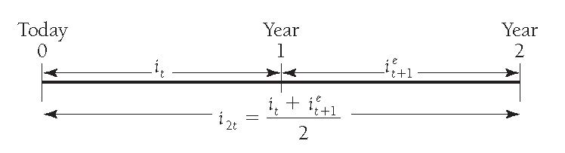
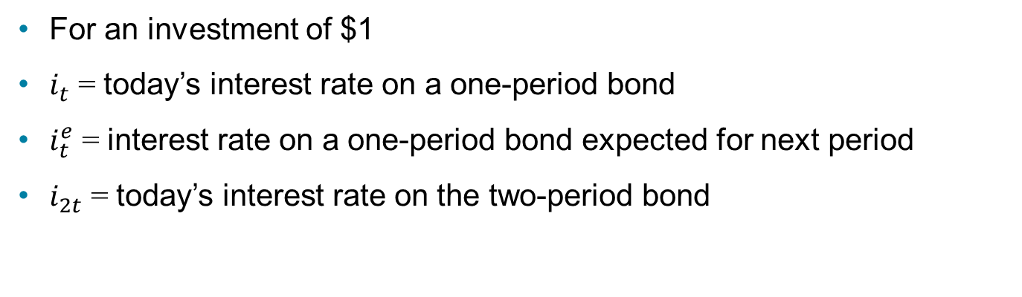
Expectations Theory (3 of 7)
For an investment of $1
$i_{t}$ = today’s interest rate on a one-period bond
$i_{t}^{e}$= interest rate on a one-period bond expected for next period
$i_{2t}$= today’s interest rate on the two-period bond

Slide 23
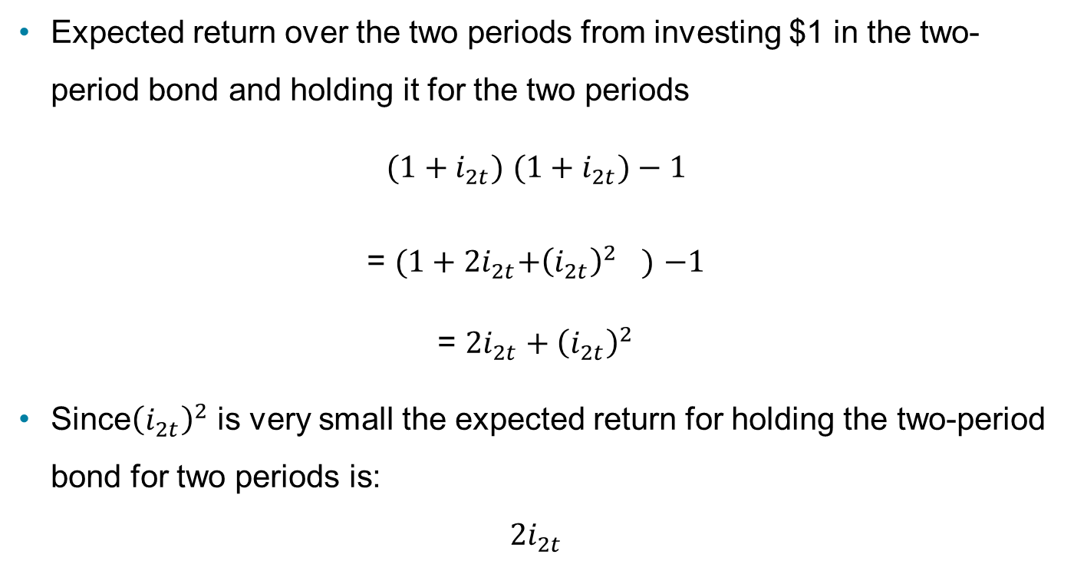
Expectations Theory (4 of 7)
Expected return over the two periods from investing $1 in the two-period bond and holding it for the two periods
${(1+i}_{2t})$ ${(1+i}_{2t})−1$
= ${(1+2i}_{2t}+{{\left(i_{2t}\right)}^{2}}^{})$ $−1$
= ${2i}_{2t}+{\left(i_{2t}\right)}^{2}$
Since${\left(i_{2t}\right)}^{2}$ is very small the expected return for holding the two-period bond for two periods is:
$${2i}_{2t}$$

Slide 24
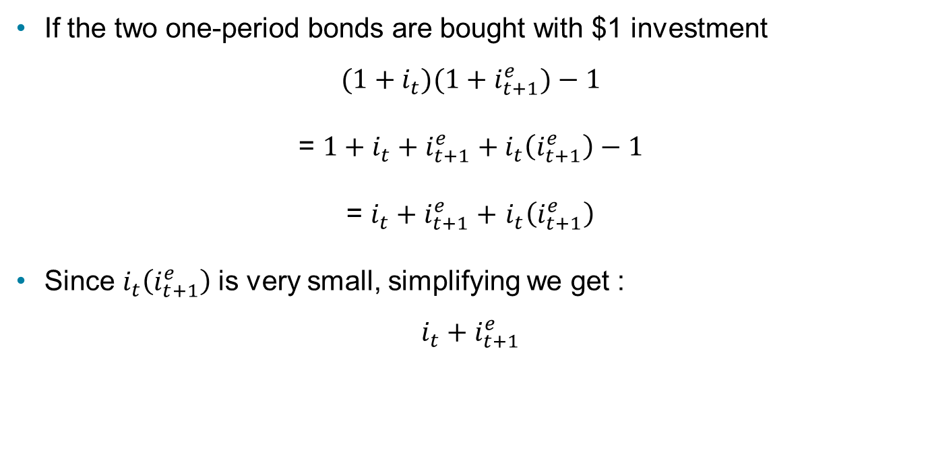
Expectations Theory (5 of 7)
If the two one-period bonds are bought with $1 investment
$${(1+i}_{t})(1+i_{t+1}^{e})−1$$
= $1+i_{t}+i_{t+1}^{e}+i_{t}\left(i_{t+1}^{e}\right)−1$
= $i_{t}+i_{t+1}^{e}+$ $i_{t}\left(i_{t+1}^{e}\right)$
Since $i_{t}\left(i_{t+1}^{e}\right)$is very small, simplifying we get :
$$i_{t}+i_{t+1}^{e}$$

Slide 25
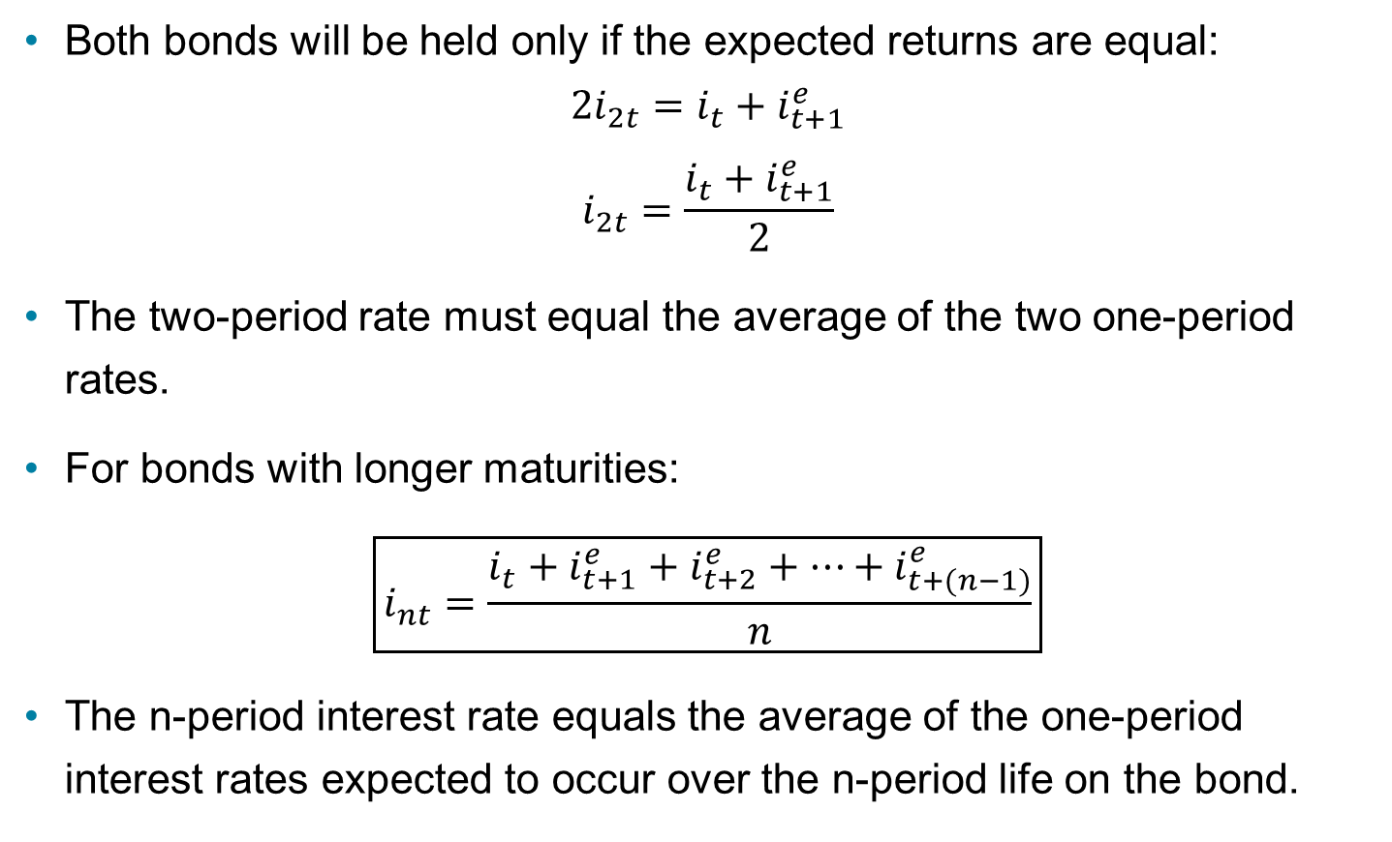
Expectations Theory (6 of 7)
Both bonds will be held only if the expected returns are equal:
$$2i_{2t}=i_{t}+i_{t+1}^{e}$$
$$i_{2t}=\frac{i_{t}+i_{t+1}^{e}}{2}$$
The two-period rate must equal the average of the two one-period rates.
For bonds with longer maturities:
$$\boxed{i_{nt}=\frac{i_{t}+i_{t+1}^{e}+i_{t+2}^{e}+…+i_{t+(n−1)}^{e}}{n}}$$
The n-period interest rate equals the average of the one-period interest rates expected to occur over the n-period life on the bond.

Slide 26
Expectations Theory (7 of 7)
Expectations theory explains:
Why the term structure of interest rates changes at different times.
Why interest rates on bonds with different maturities move together over time (fact 1).
Why yield curves tend to slope up when short-term rates are low and slope down when short-term rates are high (fact 2).
Cannot explain why yield curves usually slope upward (fact 3)

Slide 27
Segmented Markets Theory
Bonds of different maturities are not substitutes at all.
The interest rate for each bond with a different maturity is determined by the demand for and supply of that bond.
Investors have preferences for bonds of one maturity over another.
If investors generally prefer bonds with shorter maturities that have less interest-rate risk, then this explains why yield curves usually slope upward (fact 3).

Slide 28
Liquidity Premium & Preferred Habitat Theories (1 of 2)
The interest rate on a long-term bond will equal an average of short-term interest rates expected to occur over the life of the long-term bond plus a liquidity premium that responds to supply and demand conditions for that bond.
Bonds of different maturities are partial (not perfect) substitutes.

Slide 29
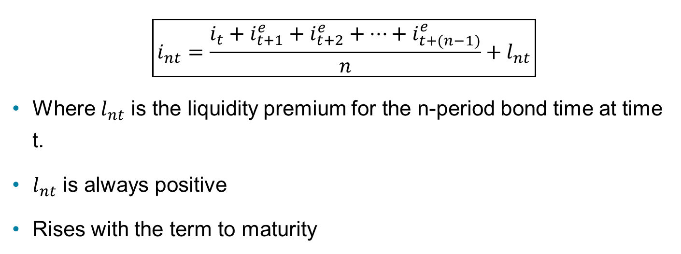
Liquidity Premium Theory
$$\boxed{i_{nt}=\frac{i_{t}+i_{t+1}^{e}+i_{t+2}^{e}+…+i_{t+(n−1)}^{e}}{n}+l_{nt}}$$
Where $l_{nt}$ is the liquidity premium for the n-period bond time at time t.
$l_{nt}$ is always positive
Rises with the term to maturity

Slide 30
Preferred Habitat Theory
Investors have a preference for bonds of one maturity over another.
They will be willing to buy bonds of different maturities only if they earn a somewhat higher expected return.
Investors are likely to prefer short-term bonds over longer-term bonds.

Slide 31
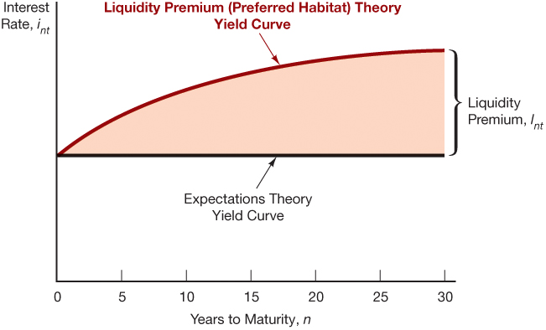
The Relationship Between the Liquidity Premium (Preferred Habitat) and Expectations Theory

Slide 32
Liquidity Premium & Preferred Habitat Theories (2 of 2)
Interest rates on different maturity bonds move together over time; explained by the first term in the equation.
Yield curves tend to slope upward when short-term rates are low and to be inverted when short-term rates are high; explained by the liquidity premium term in the first case and by a low expected average in the second case
Yield curves typically slope upward; explained by a larger liquidity premium as the term to maturity lengthens.

Slide 33
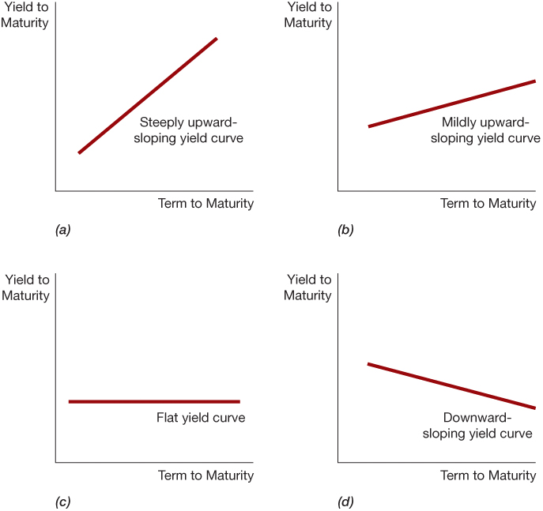
Yield Curves and the Market’s Expectations of Future Short-Term Interest Rates According to the Liquidity Premium (Preferred Habitat) Theory

Slide 34
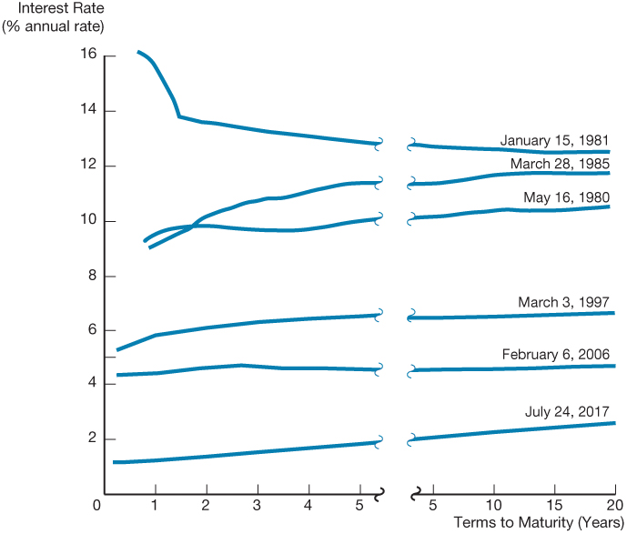
Yield Curves for U.S. Government Bonds

